Slide 1
Sequential Logic Design
Register file, Multi-function Register, FSM, Controller

Slide 2
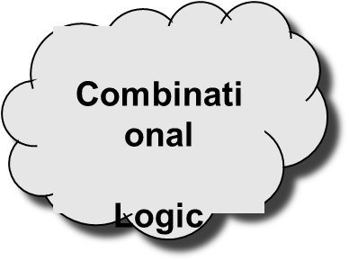

Register Transfer Level Design Description
Combinational logic
…
Registers

Slide 3
ALU Example:
Reg File
Reg File
8
8
A
B
Design using ALU is elegant and efficient
x
A
B
y
x
ALU
z
y
z
S
8
e
ld
clk
8-bit register
8
C
A
L
C
LEDs

Slide 4
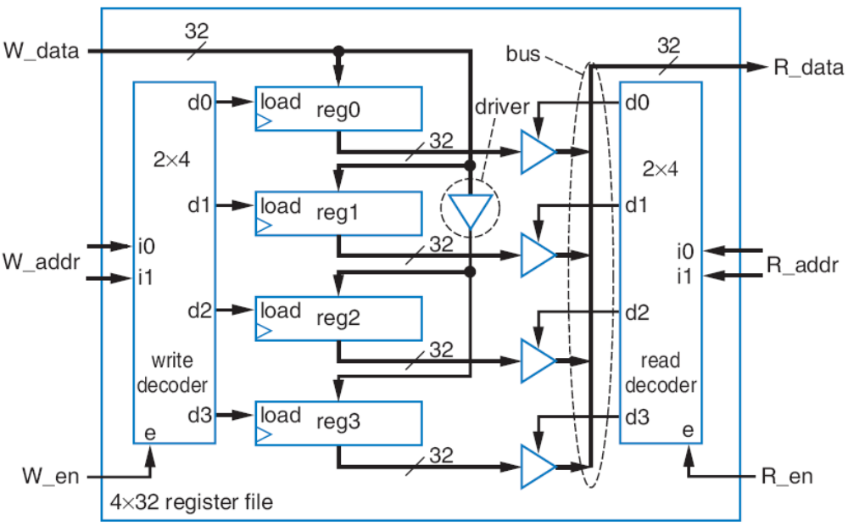
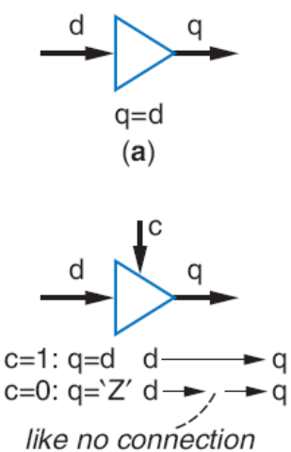
Register File
Instead, want component that has one data input and one data output, and allows us to specify which internal register to write and which to read
32
32
W_data
R_data
a
2
W_addr
R_addr
2
W_en
R_en
4x32
register file
a

Slide 5
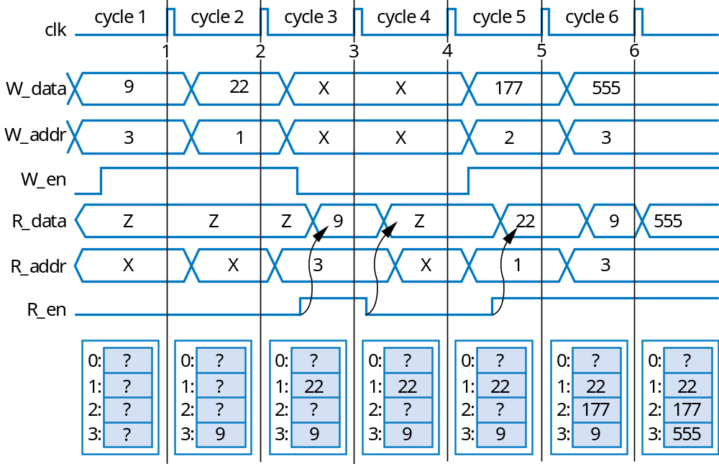
Register File Timing Diagram
Can write one register and read one register each clock cycle
  May be same register
32
32
W_data
R_data
2
W_addr
R_addr
2
W_en
R_en
4x32
register file
16x32
32
32
W_data
R_data
4
4
W_addr
R_addr
W_en
R_en
16
×
32
register file

Slide 6
Register File -size
32x32
32
32
32
32
W_data
R_data
W_data
R_data
2
W_addr
R_addr
2
5
5
W_addr
R_addr
W_en
R_en
W_en
R_en
4x32
32
×
32
register file
register file
64x64
16x32
64
64
W_data
R_data
6
32
32
6
W_data
R_data
W_addr
R_addr
4
4
W_addr
R_addr
W_en
R_en
32
×
32
W_en
R_en
register file
16
×
32
register file

Slide 7
ALU Example:
Reg File
Reg File
8
8
A
B
Design using ALU is elegant and efficient
x
A
B
y
x
ALU
z
y
z
S
8
e
ld
clk
8-bit register
8
C
A
L
C
LEDs

Slide 8
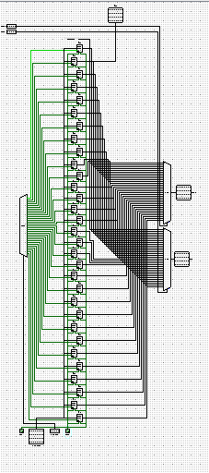
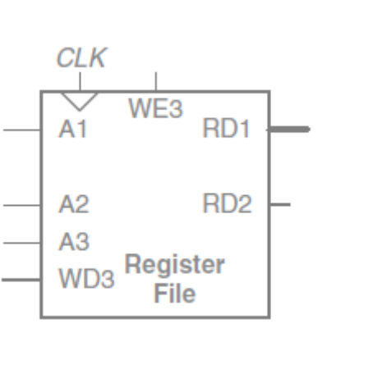
Register File with Two Ports

Slide 9
ALU Example:
Reg File two ports
8
8
A
B
Design using ALU is elegant and efficient
x
A
B
y
x
ALU
z
y
z
S
8
e
ld
clk
8-bit register
8
C
A
L
C
LEDs

Slide 10
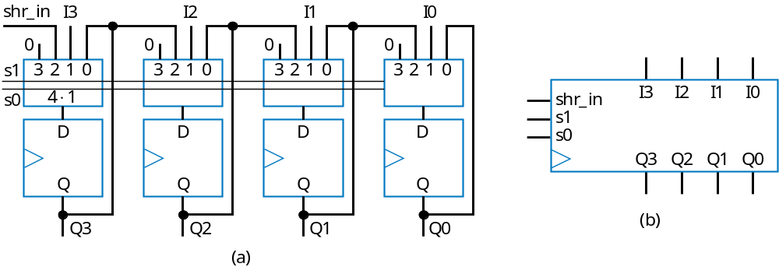
Multifunction Registers
Many registers have multiple functions
  Load, shift, clear (load all 0s)
  And retain present value, of course
Easily designed using muxes
  Just connect each mux input to achieve desired function
Functions:
s1
s0
Operation
0
0
Maintain present value
0
1
Parallel load
1
0
Shift right
1
1
(unused - let's load 0s)

Slide 11
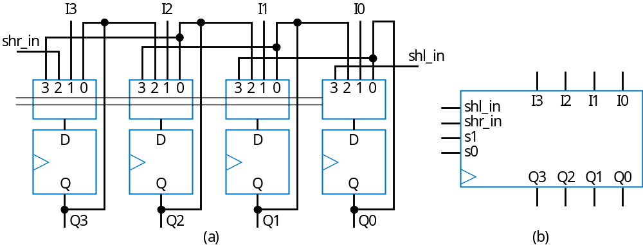
Multifunction Registers
s1
s0
Operation
0
0
Maintain present value
0
1
Parallel load
1
0
Shift right
1
1
Shift left

Slide 12
Multifunction Registers with Separate Control Inputs
ld
shr
shl
Operation
0
0
0
Maintain present value
0
0
1
Shift left
0
1
0
Shift right
0
1
1
Shift right – shr has priority over shl
1
0
0
Parallel load
1
0
1
Parallel load – ld has priority
I
3
I
2
I
1
I
0
1
1
0
Parallel load – ld has priority
shr_in
1
1
1
Parallel load – ld has priority
ld
shr_in
I
3
I
2
I
1
I
0
?
s1
shl_in
shr
c
ombi-
s0
shl_in
Truth table for combinational circuit
n
a
tional
shl
ci
r
cuit
Q3
Q2
Q1
Q0
Inputs
Outputs
Note
ld
shr
shl
s1
s0
Operation
Q3
Q2
Q1
Q0
0
0
0
0
0
Maintain value
0
0
1
1
1
Shift left
a
0
1
0
1
0
Shift right
0
1
1
1
0
Shift right
s1 = ld’*shr’*shl + ld’*shr*shl’ + ld’*shr*shl
s0 = ld’*shr’*shl + ld
1
0
0
0
1
Parallel load
1
0
1
0
1
Parallel load
1
1
0
0
1
Parallel load
a
1
1
1
0
1
Parallel load
a

Slide 13
Register Operation Table
Register operations typically shown using compact version of table
  X means same operation whether value is 0 or 1
    One X expands to two rows
    Two Xs expand to four rows
  Put highest priority control input on left to make reduced table simple
Inputs
Outputs
No
t
e
ld
shr
shl
s1
s0
Operation
ld
shr
shl
Ope
r
a
tion
0
0
0
0
0
Maintain value
0
0
0
M
ai
n
tain
v
alue
0
0
1
1
1
Shift left
0
0
1
Shi
f
t le
f
t
0
1
0
1
0
Shift right
0
1
X
Shift right
0
1
1
1
0
Shift right
1
X
X
Parallel load
1
0
0
0
1
Parallel load
1
0
1
0
1
Parallel load
1
1
0
0
1
Parallel load
1
1
1
0
1
Parallel load

Slide 14
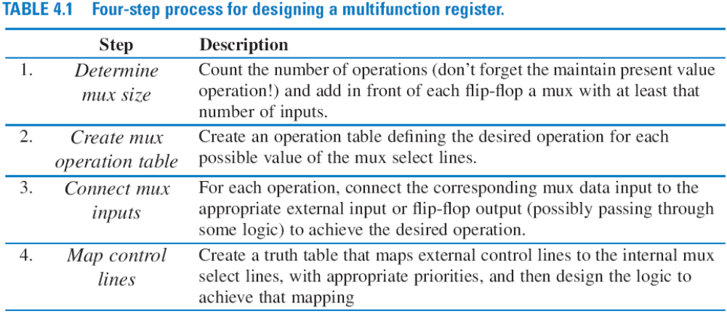
Register Design Process
Can design register with desired operations using simple four-step process

Slide 15
Register Design Example
s2
s1
s0
Operation
Desired register operations
  Load, shift left, synchronous clear, synchronous set
0
0
0
Maintain present value
0
0
1
Parallel load
0
1
0
Shift left
0
1
1
Synchronous clear
1
0
0
Synchronous set
Step 1: Determine mux size
1
0
1
Maintain present value
1
1
0
Maintain present value
1
1
1
Maintain present value
5 operations: above, plus maintain present value (don’t forget this one!) --> Use 8x1 mux
In
1
0
from
a
Qn-1
s2
7
6
5
4
3
2
1
0
s1
Step 2: Create mux operation table
s0
D
Step 3: Connect mux inputs
Q
Step 4: Map control lines
Qn
Inputs
Outputs
s2 = clr’*set
s1 = clr’*set’*ld’*shl + clr
s0 = clr’*set’*ld + clr
clr
set
ld
shl
s2
s1
s0
Operation
0
0
0
0
0
0
0
Maintain present value
0
0
0
1
0
1
0
Shift left
0
0
1
X
0
0
1
Parallel load
0
1
X
X
1
0
0
Set to all 1s
1
X
X
X
0
1
1
Clear to all 0s
a

Slide 16
Register Design Example
I
3
I
2
I
1
I
0
shl
s2
I
3
I
2
I
1
I
0
ld
combi-
s1
shl_in
shl_in
national
s0
set
circuit
Q3
Q2
Q1
Q0
clr
Q3
Q2
Q1
Q0
Step 4: Map control lines
Inputs
Outputs
s2 = clr’*set
s1 = clr’*set’*ld’*shl + clr
s0 = clr’*set’*ld + clr
clr
set
ld
shl
s2
s1
s0
Operation
0
0
0
0
0
0
0
Maintain present value
0
0
0
1
0
1
0
Shift left
0
0
1
X
0
0
1
Parallel load
0
1
X
X
1
0
0
Set to all 1s
1
X
X
X
0
1
1
Clear to all 0s

Slide 17
Finite-State Machines (FSMs) and Controllers

Slide 18
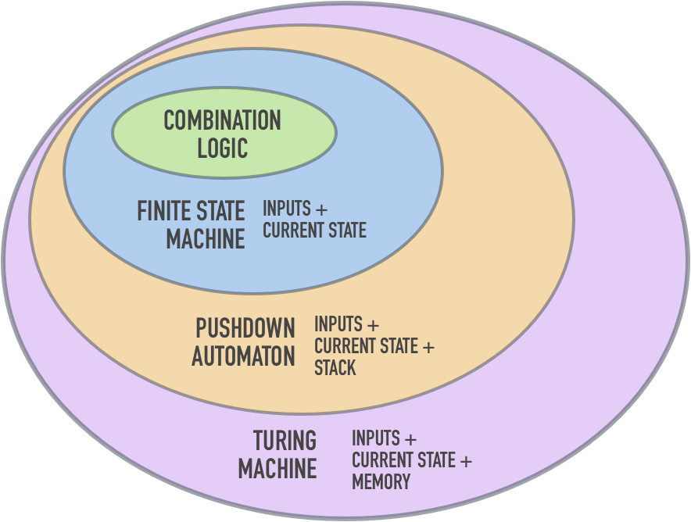

Slide 19
Mealy and Moore machines
Mealy machines tend to have fewer states
Mealy machines react faster to inputs
Moore machines are generally safer to use
  outputs change at clock edge (always one cycle later)
  in Mealy machines, input change can cause output change as soon as logic is done
inputs
combinational
logic for
next state
inputs
logic for
outputs
outputs
reg
logic for
outputs
outputs
combinational
logic for
next state
reg
state feedback
state feedback

